Slide 1
Basic Encryption / Boolean Logic
The art of secret messages

Slide 2
What is cryptography?
Cryptography is defined as “the science or study of the techniques of secret writing, especially code and cipher systems, methods, and the like” (dictionary.com). In short, cryptography is coming up with secret codes!
Some of the more common ciphers are:
Substitution ciphers (Caesar shift, ROT13, etc.)
Polyalphabetic ciphers (Vigenere)
Transposition ciphers (Rail fence, syctale, etc.)

Slide 3
A brief history
The earliest known use of cryptography dates back to around 1900 BC, with some hieroglyphs carved into the wall of an ancient Egyptian tomb (ranksecure.in).
Most traditional cryptography consisted of simple substitution/shift ciphers, such as the Caesar cipher, used by Julius Caesar to communicate in secret.
In the age of computers, we use encryption for things like online privacy, securing passwords, and processing digital currency.

Slide 4
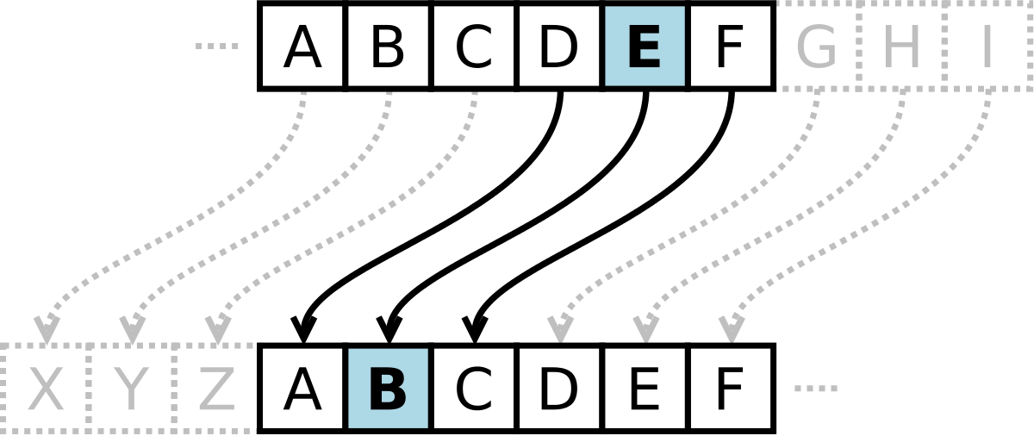
Caesar cipher
The caesar cipher consists of a ciphertext and a key. Place two alphabets on top of each other. The key may be any letter. Shift the letters of the top alphabet until the A matches up with the key letter on the bottom alphabet.
SECRET MESSAGES = PBZOBQ JBPPXDBP
The key is X

Slide 5
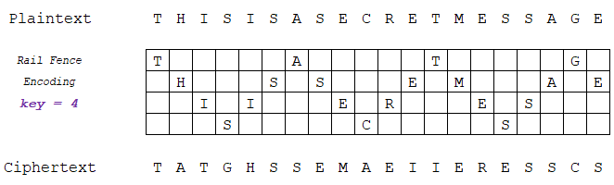
Rail Fence Cipher
In a rail fence cipher, the key can be any number less than the length of the ciphertext.
Place the letters of your message in a zig-zag pattern. The key is how many letters you place before changing direction. Then, read the letters from left to right, starting at the top.
SECRET MESSAGES = S GETMAECEESSRS

Slide 6
Boolean Logic
Believe it or not, you most likely already have a basic understanding of boolean logic. If you’ve ever said something like, “I want ice cream AND sprinkles” or “I want pizza AND NOT pineapple,” those are boolean statements!
A boolean expression takes a few inputs, all of which are either true or false, and compares them to give a single result that is either true or false.
True AND False = False
True OR False = True

Slide 7
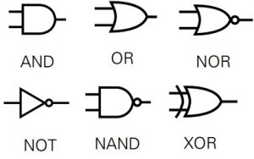
Boolean Operations
The standard boolean operations are AND, OR, and NOT. These three can be combined in different ways to form NOR and NAND. We will discuss XOR in a moment.

Slide 8
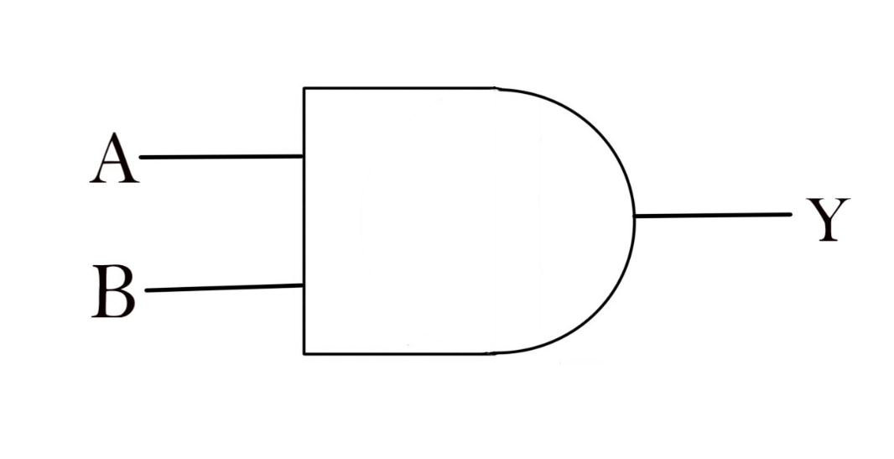
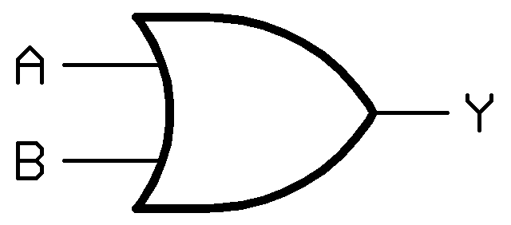
AND / OR
AND will return True only if both inputs are True.
OR will return True if at least one of the inputs are True.
True
AND
True
True
True
OR
True
False

Slide 9
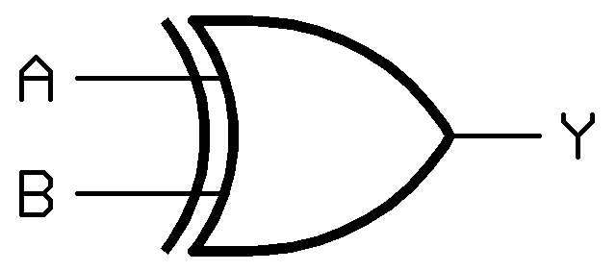
XOR
XOR stands for Exclusive Or. XOR will return true if only one of the inputs are True. If both inputs are True, XOR will return false.
In other words, XOR will only return True if the inputs are different from each other, and False if they are the same.
True
XOR
False
True
False
XOR
False
False
True
XOR
True
False

Slide 10
Encryption with XOR
XOR can be used as a method of cryptography. In computers, each character is represented by a single-byte (8-bit) binary number (ASCII Encoding). A is 01000001, B is 01000010, C is 01000011, and so on.
XOR encryption involves taking a key (usually a single byte), and performing the XOR operation on each character. After every byte of the plaintext message has been XORed by the key, you have your ciphertext.
An example can be seen on the next slide.

Slide 11
Encryption with XOR
In this example, we’ve chosen a key of 1F (hex) or 00011111 (binary). For the sake of our XOR operations, assume 1 = True and 0 = False.
Let’s encrypt the word “XOR”.
Using XOR encryption with a key of 1F:
XOR = GPM
SECRET MESSAGES = LZ\MZK?RZLL^XZL
X = 01011000
Key = 00011111
XOR —-------------
Result = 01000111 = G
O = 01001111
Key = 00011111
XOR —-------------
Result = 01010000 = P
R = 01010010
Key = 00011111
XOR —-------------
Result = 01001101 = M

Slide 12
Types of Encoding / How to Differentiate
43 72 79 70 74 6f 20 69 73 20 63 6f 6f 6c

Slide 13
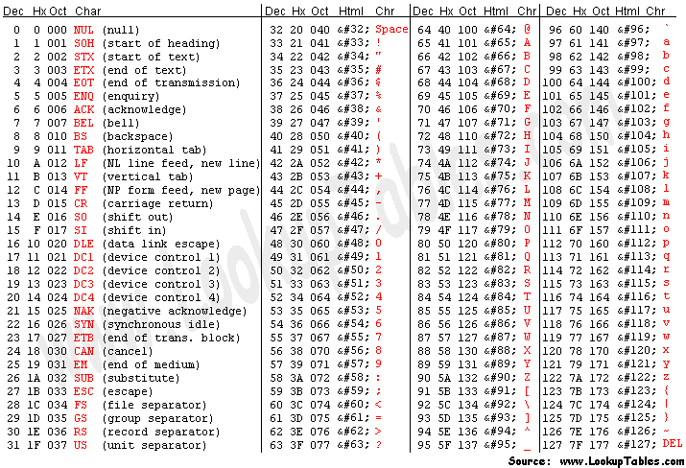
Modern text encoding (ASCII)
In modern computers, text is almost always encoded using a scheme called ASCII, which stands for “American Standard Code for Information Interchange.”
Each character is represented by a single byte of binary data. In decimal, these values range from 32 - 126.
Whenever we want to represent letters using numbers, we will use ASCII.

Slide 14
Different number bases
In cryptography, you will frequently see text encoded using a variety of number bases.
The most commonly used ones are:
Binary (base 2)
Octal (base 8)
Decimal (base 10)
Hexadecimal (base 16)
Base 64

Slide 15
Binary (base 2)
Binary is perhaps the most easily recognizable base encoding, as it consists solely of a sequence of 1s and 0s. Given a binary encoded message, it will look something like this:
01000010 01001001 01001110 01000001 01010010 01011001

Slide 16
Octal (base 8)
An octal encoded string will consist entirely of numbers ranging from 0 to 7.
0, 1, 2, 3, 4, 5, 6, 7 (That’s 8 possible numbers!)
A message encrypted using base 8 will look like this:
117 103 124 101 114

Slide 17
Hexadecimal (base 16)
Hexadecimal is one of the most commonly used bases in computers. In hex, there are 16 possible values for each digit, ranging from 0 - F. A hex encoded string will look like this:
48 45 58 41 44 45 43 49 4D 41 4C

Slide 18
Base 64
Base 64 encoding is another easily recognizable scheme. There are 64 different possible values for each digit. Characters from A-Z, a-z, 0-9, +, and / are used. A base 64 encoded string may also have one or two equals signs at the end as padding. Here is an example of a base 64 encoded string:
QmFzZSA2NCBsb29rcyByZWFsbHkgZnVua3k=

